Slide 1
WEB APPLICATION FOR LOCATION DIRECTORY
Presented By :
BALAJI J
(Reg.no : 20Y005)
Internal Guide: External Guide:
Prof. N.Murali, V.Prabhu,
Associate Professor, Technical Lead,
Department Of Computer Application, AstroWeb Solutions,
Thiagarajar College Of Engineering Simmakkal,
Madurai. Madurai.

Slide 2
SYNOPSIS
Abstract
Functionalities with Description
Risk Analysis
Database Design
Comparison with existing system
Unit Testing
Integration testing
Reference

Slide 3
Abstract
The project is to be implemented on Madurai city in which it helps the user to find location based on various category. Directories contain a large number of listings under different categories. It is community driven and built on user generated content.

Slide 4
FUNCTIONALITIES
Generic Components include – Admin Module, Register / Login module, Dashboard, Edit profile & Change password, My listings, Submit listing.
Register / Login Module
Deals with login page UX design template. Register/ login account is about verification of user detail such as mail id and password. However, the authorization process of this is to give access in the form of approval to the user. So that after the approval the one can able to access the web app.
DASHBOARD
It deals with the details of how many listings of places have published and how many of them are in pending.

Slide 5
EDIT PROFILE & CHANGE PASSWORD
It is used to update the Name, gmail and phone number and Used to change the current password to a new one.
MY LISTING
It is used to show all the places that are listed by the admin and the listings module can only be accessed by admin to proceed various activities like edit the information about a place, delete and publish a record.
SUBMIT LISTING
This Module needs information’s about a specific place like Title, Description, Logo, Address, Location, Latitude and Longitude for a place provided by using map, Business Details, Social Media Links, video and images about the place.Submit listing is the process that will upload the new places to this application. The admin uploads the places. The uploaded articles can view by all users. User can search based on the categories, then it will show all the uploaded places to user.

Slide 6
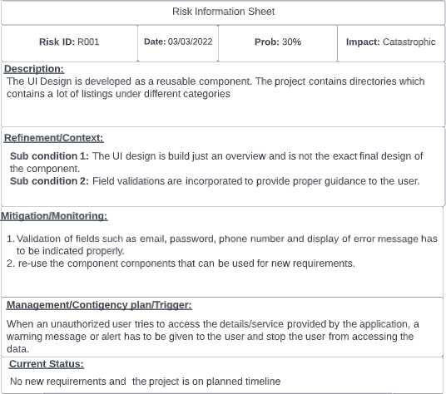
Risk Analysis

Slide 7
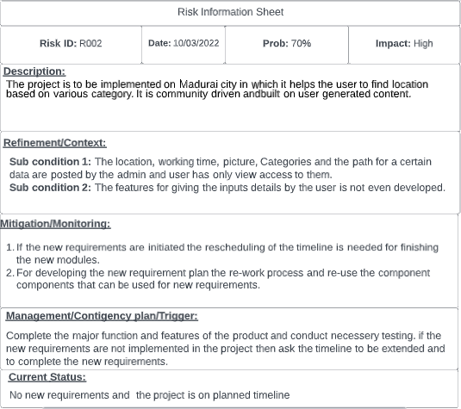

Slide 8
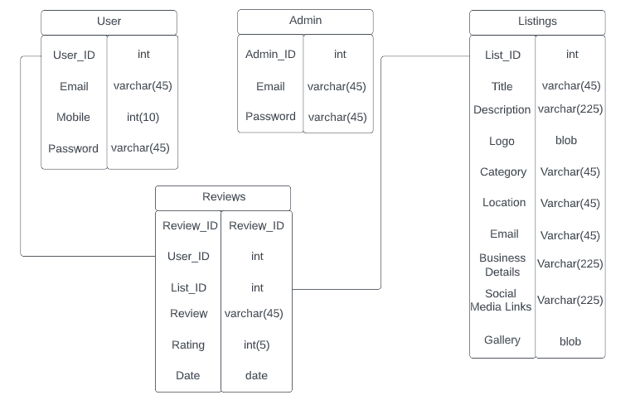
Database Design
*
*
*
*

Slide 9
Comparison with existing System
Bing maps | Proposed System
In the mobile view of the application, the visual is collapsed. | Improved UI design to maintain a good view in the mobile.
Users just see what admin uploaded cannot able to give feedback. | Users can able give their feedback using comment and rating.
There is a less categorized list of location and hard for the user to give approximate keyword. | There is a lot of categories and list of locations, user can found the place easily by searching them.
Sometimes the route is not accurate. | Improved the approximation of the route.
Analysing the behaviour of the user preference is not possible because of limited data collection. | Current data can be added easily and updated with information collecting and analysing the user behaviour and preference and predicting what users will like based on similarity to other users.

Slide 10
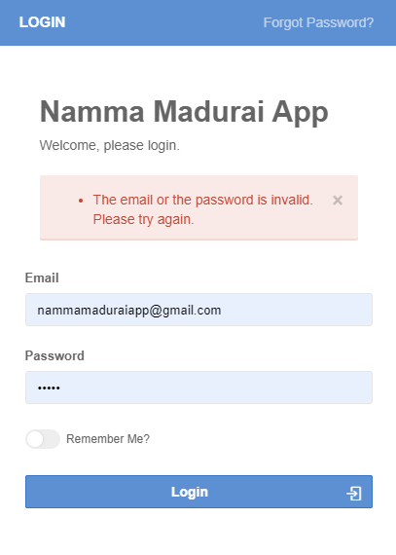
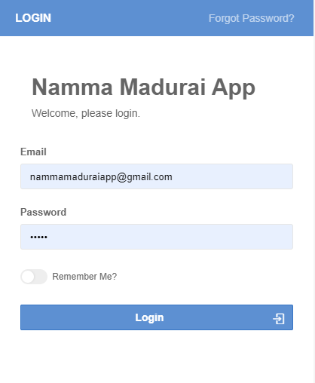
UNIT TESTING
Login – Negative Testing (UT_001)
Login – Positive Testing (UT_002)

Slide 11
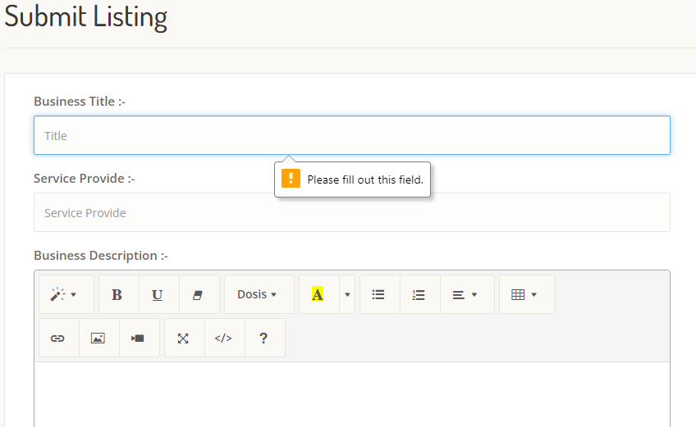
Unit Testing
Submit Listing – Negative Testing (UT_003)

Slide 12
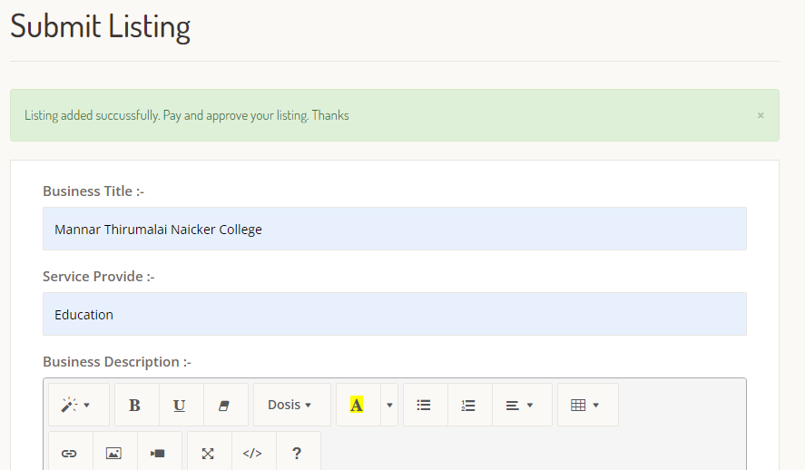
Unit Testing
Submit Listing – Positive Testing (UT_004)

Slide 13
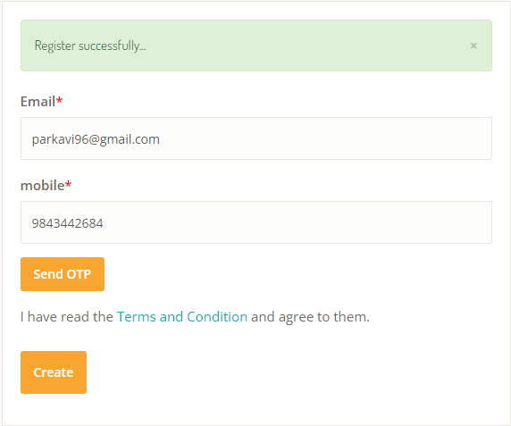
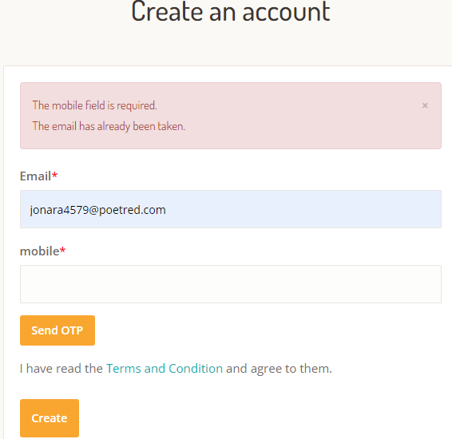
Unit Testing
Register Listing – Positive Testing (UT_005)
Register Listing – Negative Testing (UT_006)

Slide 14
Test Cases
Test Case ID | Target Component | Test Data | Expected Result
LOGIN_TID_01 | Login | No data | Show Error Message
LOGIN_TID_02 | Login | Email, password (Incorrect) | Display “Wrong Email or Password Please try again”
LOGIN_TID_03 | Login | Email, Password | Display “Login Successful”
SIGNUP_TID_04 | Sign up | Email, Mobile, Password | Display “Sign up Successful”
UPDATE_TID_05 | Update | Email, Mobile, Password, Re enter Password | Display “Profile Updated Successfully”
ADDLIST_TID_06 | Add Details | Location, category, working time, Pictures, social media links. | Display “Listing Added Successfully”
UPDATELIST_TID_07 | Update details | Location, category, working time, Pictures, social media links. | Display “Listing Updated Successfully”

Slide 15
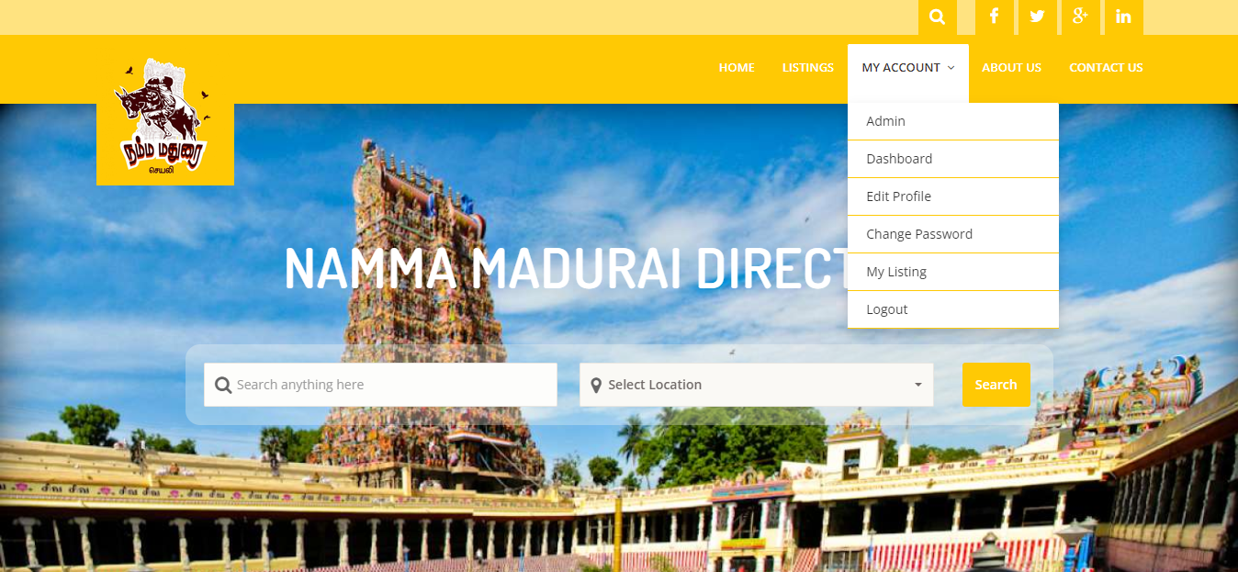
Integration Testing

Slide 16
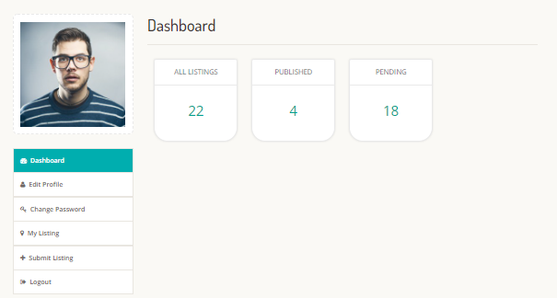
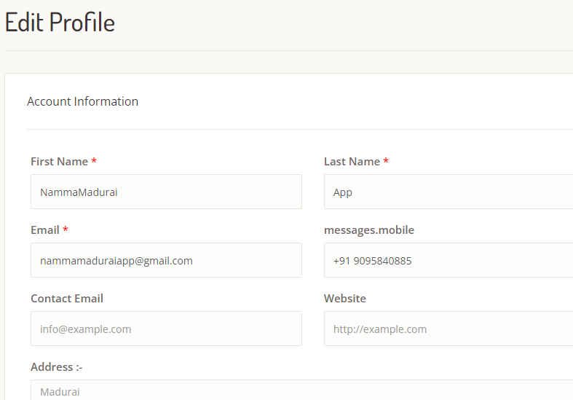

Slide 17
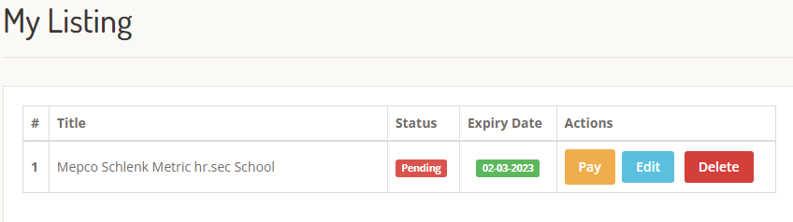
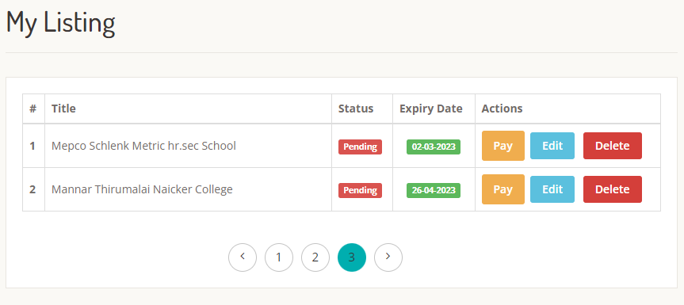

Slide 18
REFERENCES
https://codeigniter.com/userguide3/tutorial/index.html
https://astrowebsolution.com
http://groups.umd.umich.edu/cis/tinytools/cis375/f00/ris/help.html
https://lucid.app

